Slide 1




Trauma Informed Approach in education and social services
Final Evaluation Report
Project number: 101049728
Project name: Early detection, prevention and intervention of domestic violence involving children and young people through establishing the Institute for Trauma Informed Education and Care

Slide 2
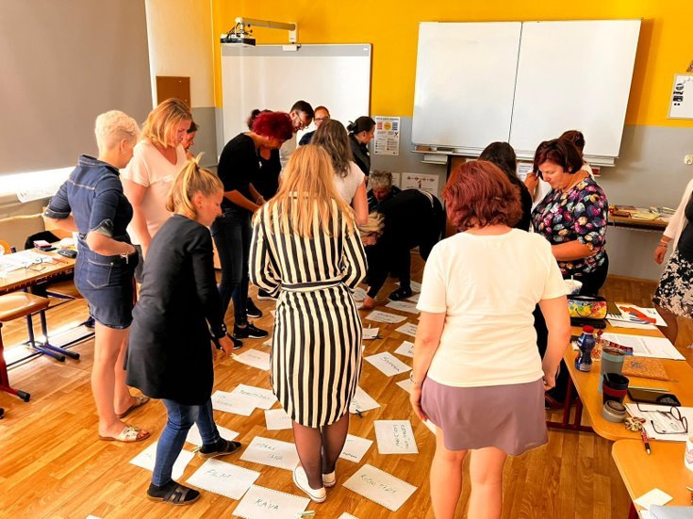
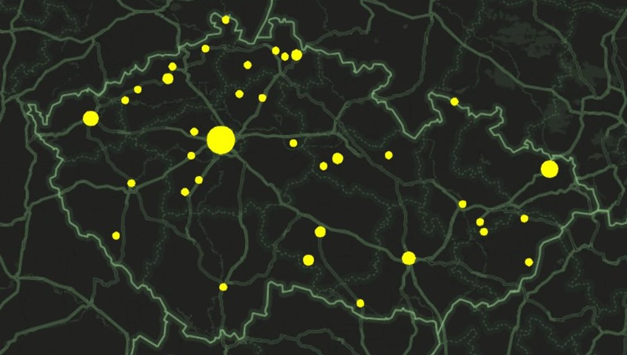
16 hours interactive training for professionals working with children within the educational and social sector
58 trainers and 1171 trainees from all 14 regions of the Czech Republic
60 trainees from V4 countries (Poland, Slovakia and Hungary)
Training materials: publication, infographics, videos, curriculum of the training, PowerPoint presentations, worksheets, additional materials

Slide 3
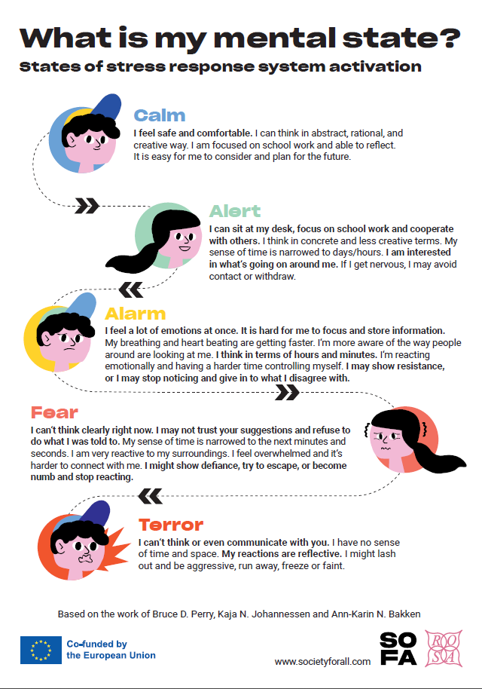
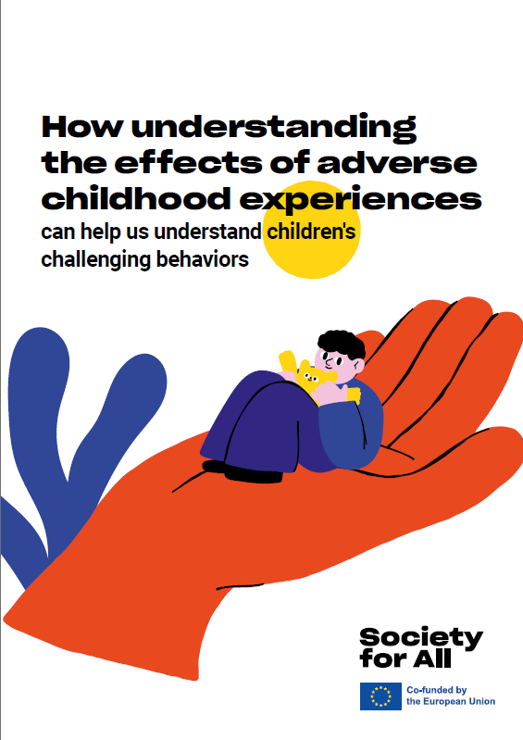
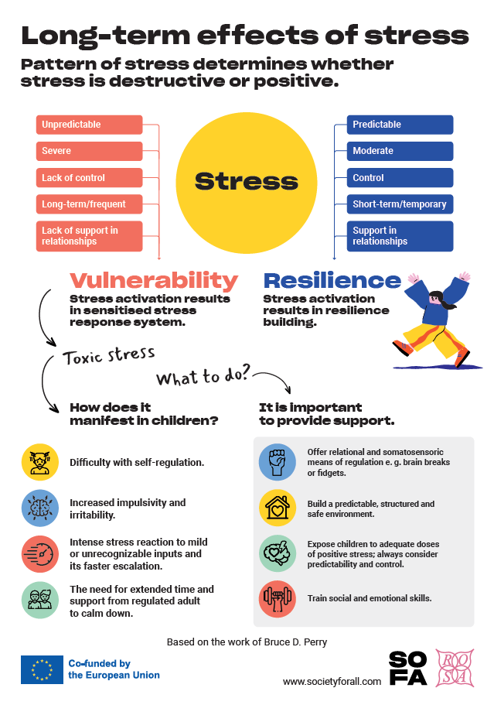

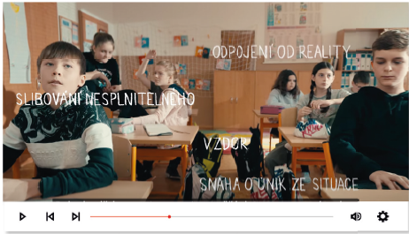
Notes:
(pozn. původně bylo "what did we do" – je lepší použít předpřítomný čas, ještě na tom budeme pracovat)

Slide 4
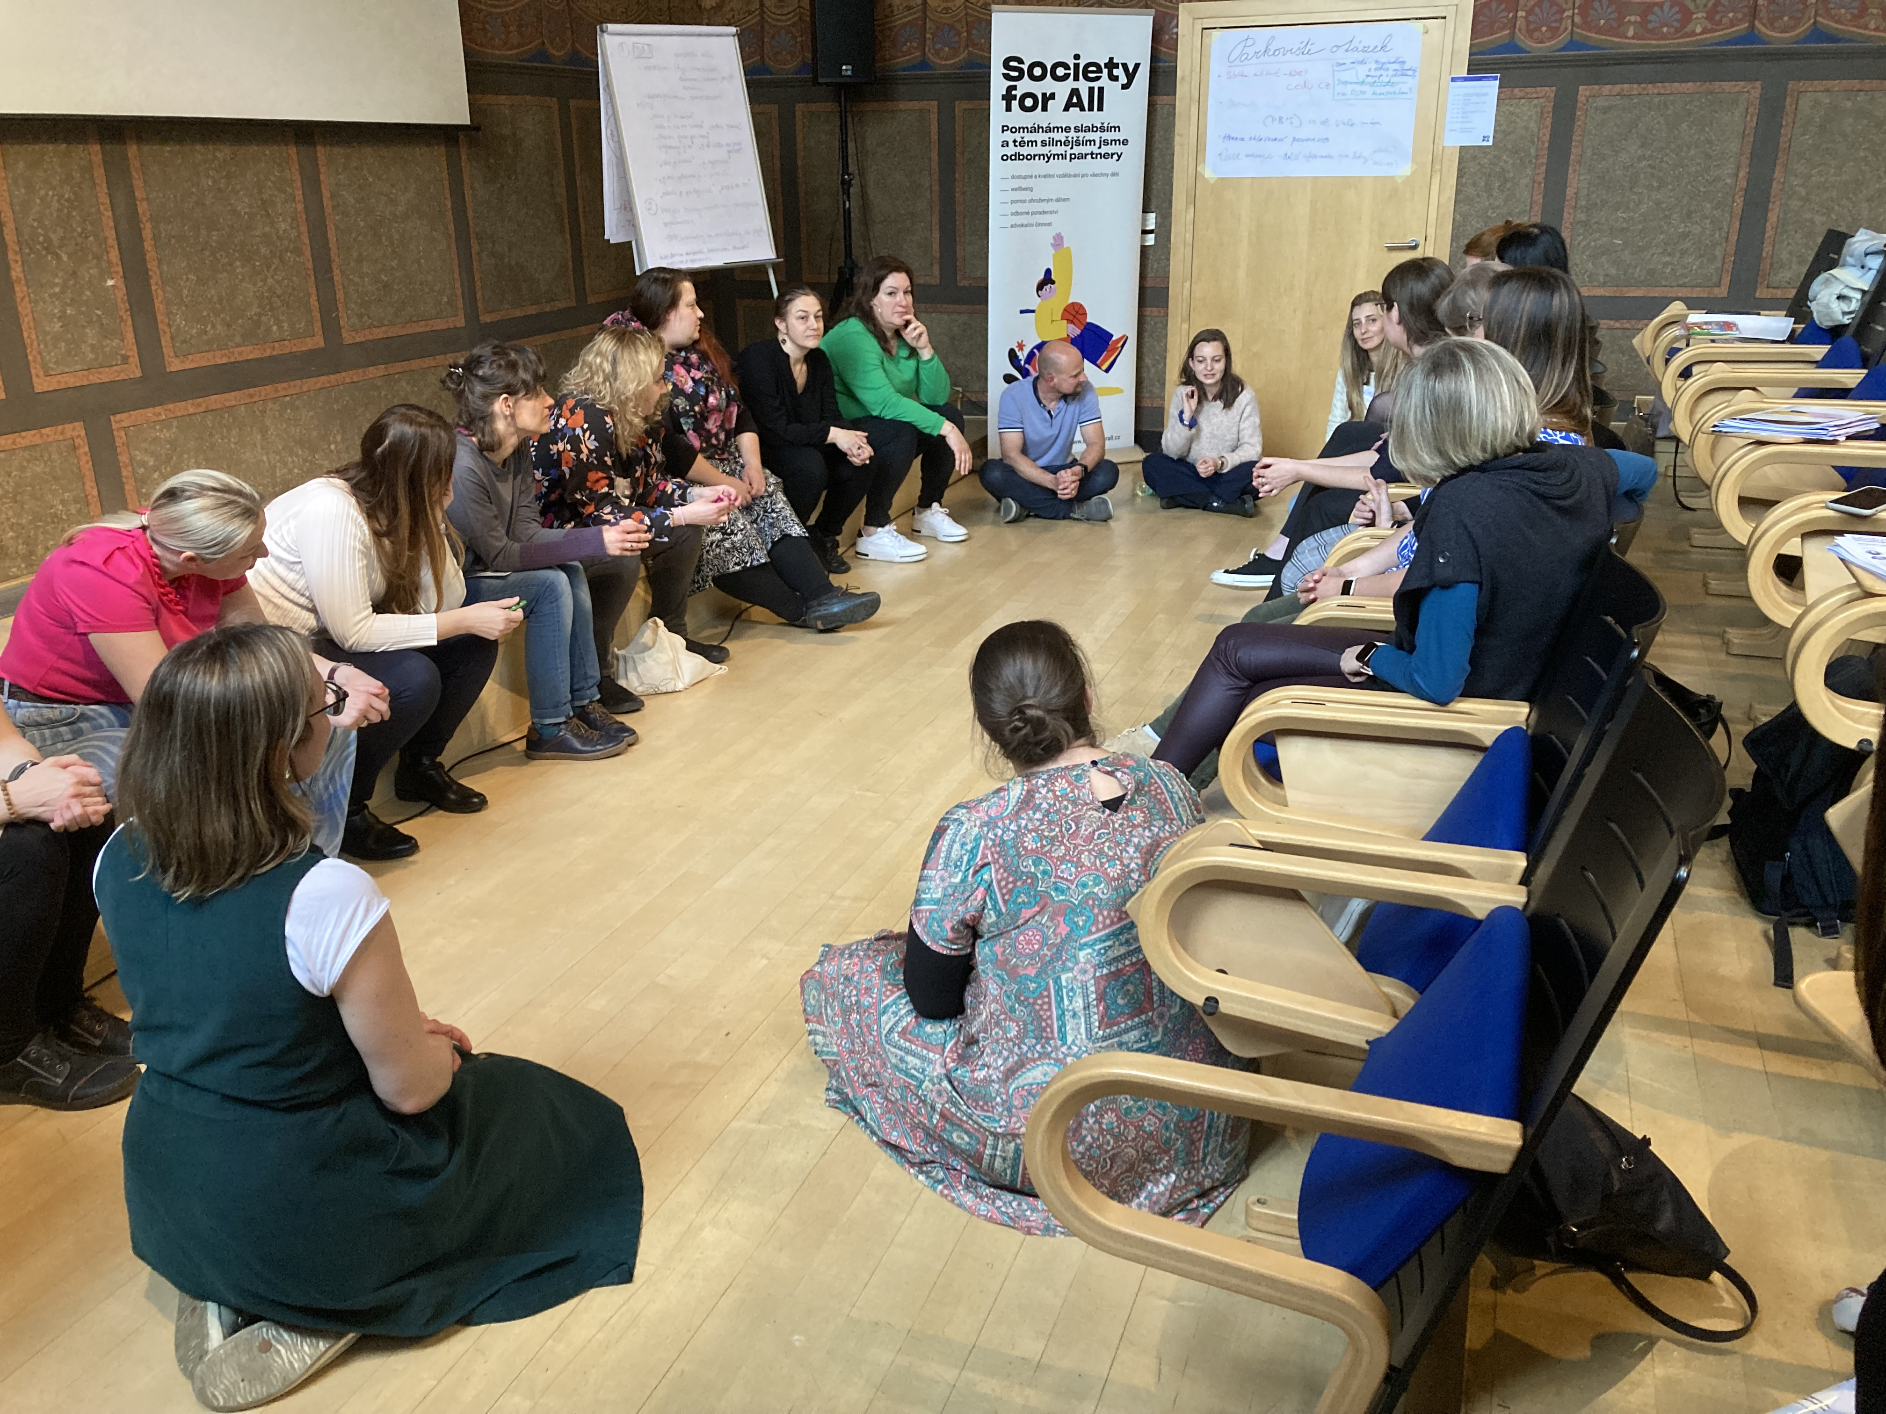
1 171 trainees and 58 trainers
Primary and secondary school teachers
High school teachers
Social workers
Special education needs teachers
Teaching assistants
Carers in children’ homes
Psychologists
Headmasters
School support services staff

Slide 5
Data collection
April till December 2023
Pre- and post- online questionnaires
876 participants filled out questionnaires before the training
649 participants filled out the questionnaires after the training
All trainees had professional experience working with children, it ranged from 0-2 years (17%) to more than 10 years of experience (44%)
Two thirds of trainees (pre- and post-) belonged to the educational sector, mostly secondary school teachers, closely followed by elementary school teachers.
Profession | Pre- | Post-
Secondary school teacher | 168 | 132
Elementary school teacher | 130 | 102
Social worker | 123 | 99
Assistant social worker | 60 | 44
Special education needs teacher | 45 | 44
Teaching assistant | 63 | 42
Carer in children’s homes | 45 | 28
Psychologist | 29 | 18
Headmaster | 20 | 16
School support staff | 15 | 11
High school teacher | 10 | 8

Slide 6
General evaluation of the course
usefulness of the course content to the participants
quality of the course content including all materials
quality of the course delivery
usefulness of individual topics covered in the course

Slide 7
Evaluation
Category A - Usefulness of the topic for my practice
In category A, the majority of participants found the course to be useful for their professional practice. 60% answered it was most useful for them, 26% thought it was useful, 12% rated neutral and only 2% did not find usefulness to their practice.
Category B – Contribution to my personal development
In category B, participants rated the course to be most beneficial (55%) or beneficial (30%) for their personal development. 10% rated neutral and only 5% did not find it beneficial. Participants with experience of up to two years rated the benefits for personal development better on average (mark 1.50), while those with experience of more than 10 years gave an average mark of 1.68. For the other two categories the differences were absolutely minimal.
Category C - Meeting course expectations
In category C, In category C, majority of participants (53% and 32%) agreed the course met their expectations. 13% rated neutral and only 2% did not find their expectations met.
Overall: Participants from the branches of Social Services vs. Education sector were practically no different in the ratings. All three categories were rated better by respondents who visited courses in the South Bohemian (1.3), Liberec or Zlín Region (1.4), the worst (2.0) then in the Central Bohemian Region.

Slide 8
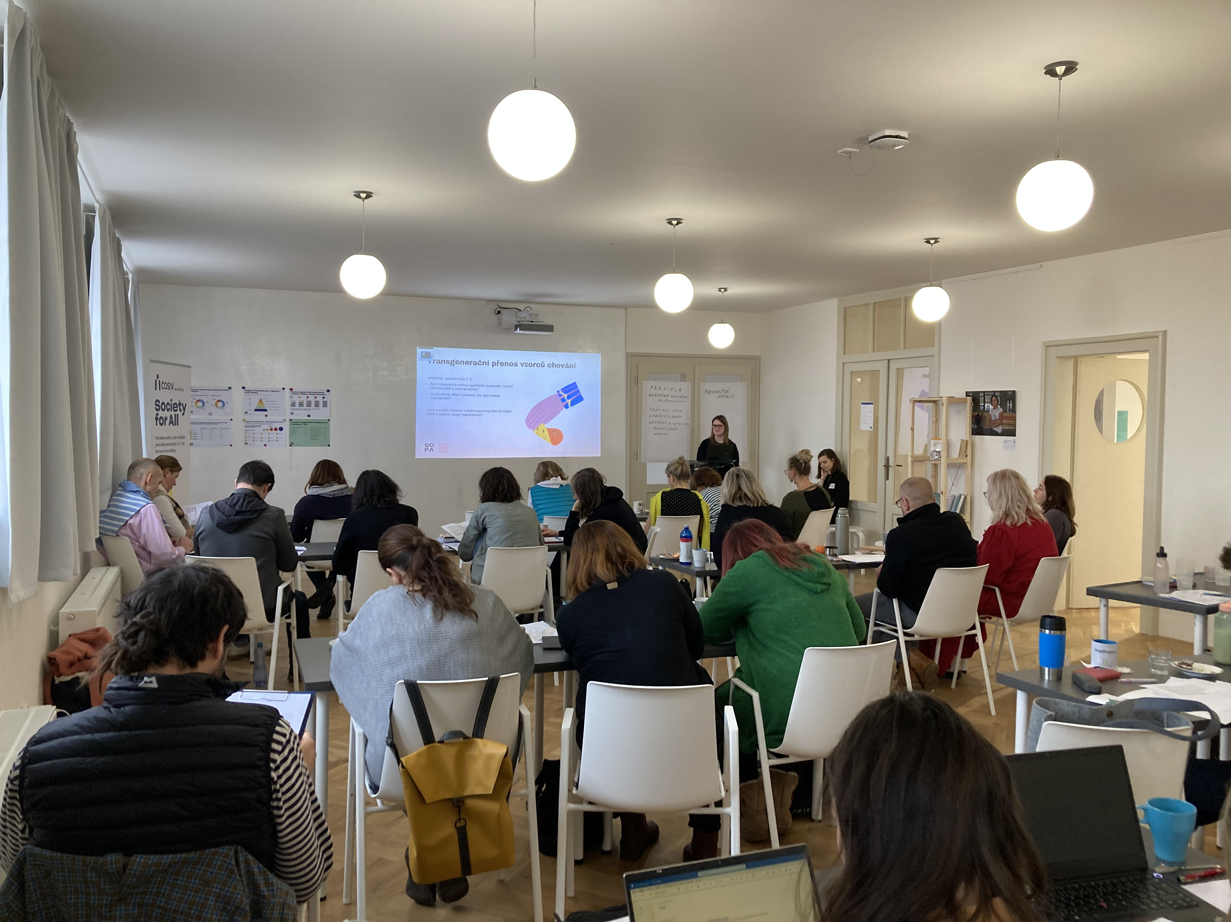

Slide 9
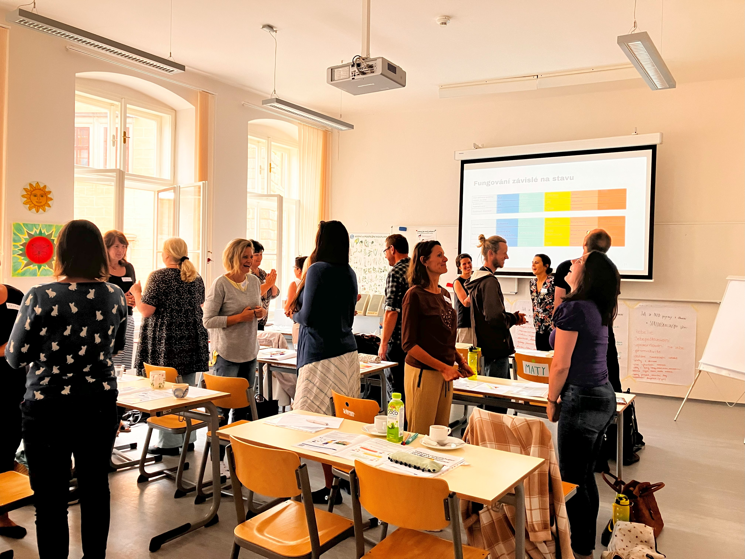
Quality of the course
The quality of the course was even better evaluated: the expertise of the materials was rated as excellent by an impressive 82% of respondents, the diversity of materials was similarly recognized by 72%, and the organization of the course by 75%.
Participants from the fields of Education vs. Social Services practically do not differ, with the largest difference being in the evaluation of the diversity of materials (1.35 vs. 1.25). Those who have been in their field for a short time, up to 2 years, as well as those with more than 10 years of experience, rated the course slightly better.

Slide 11
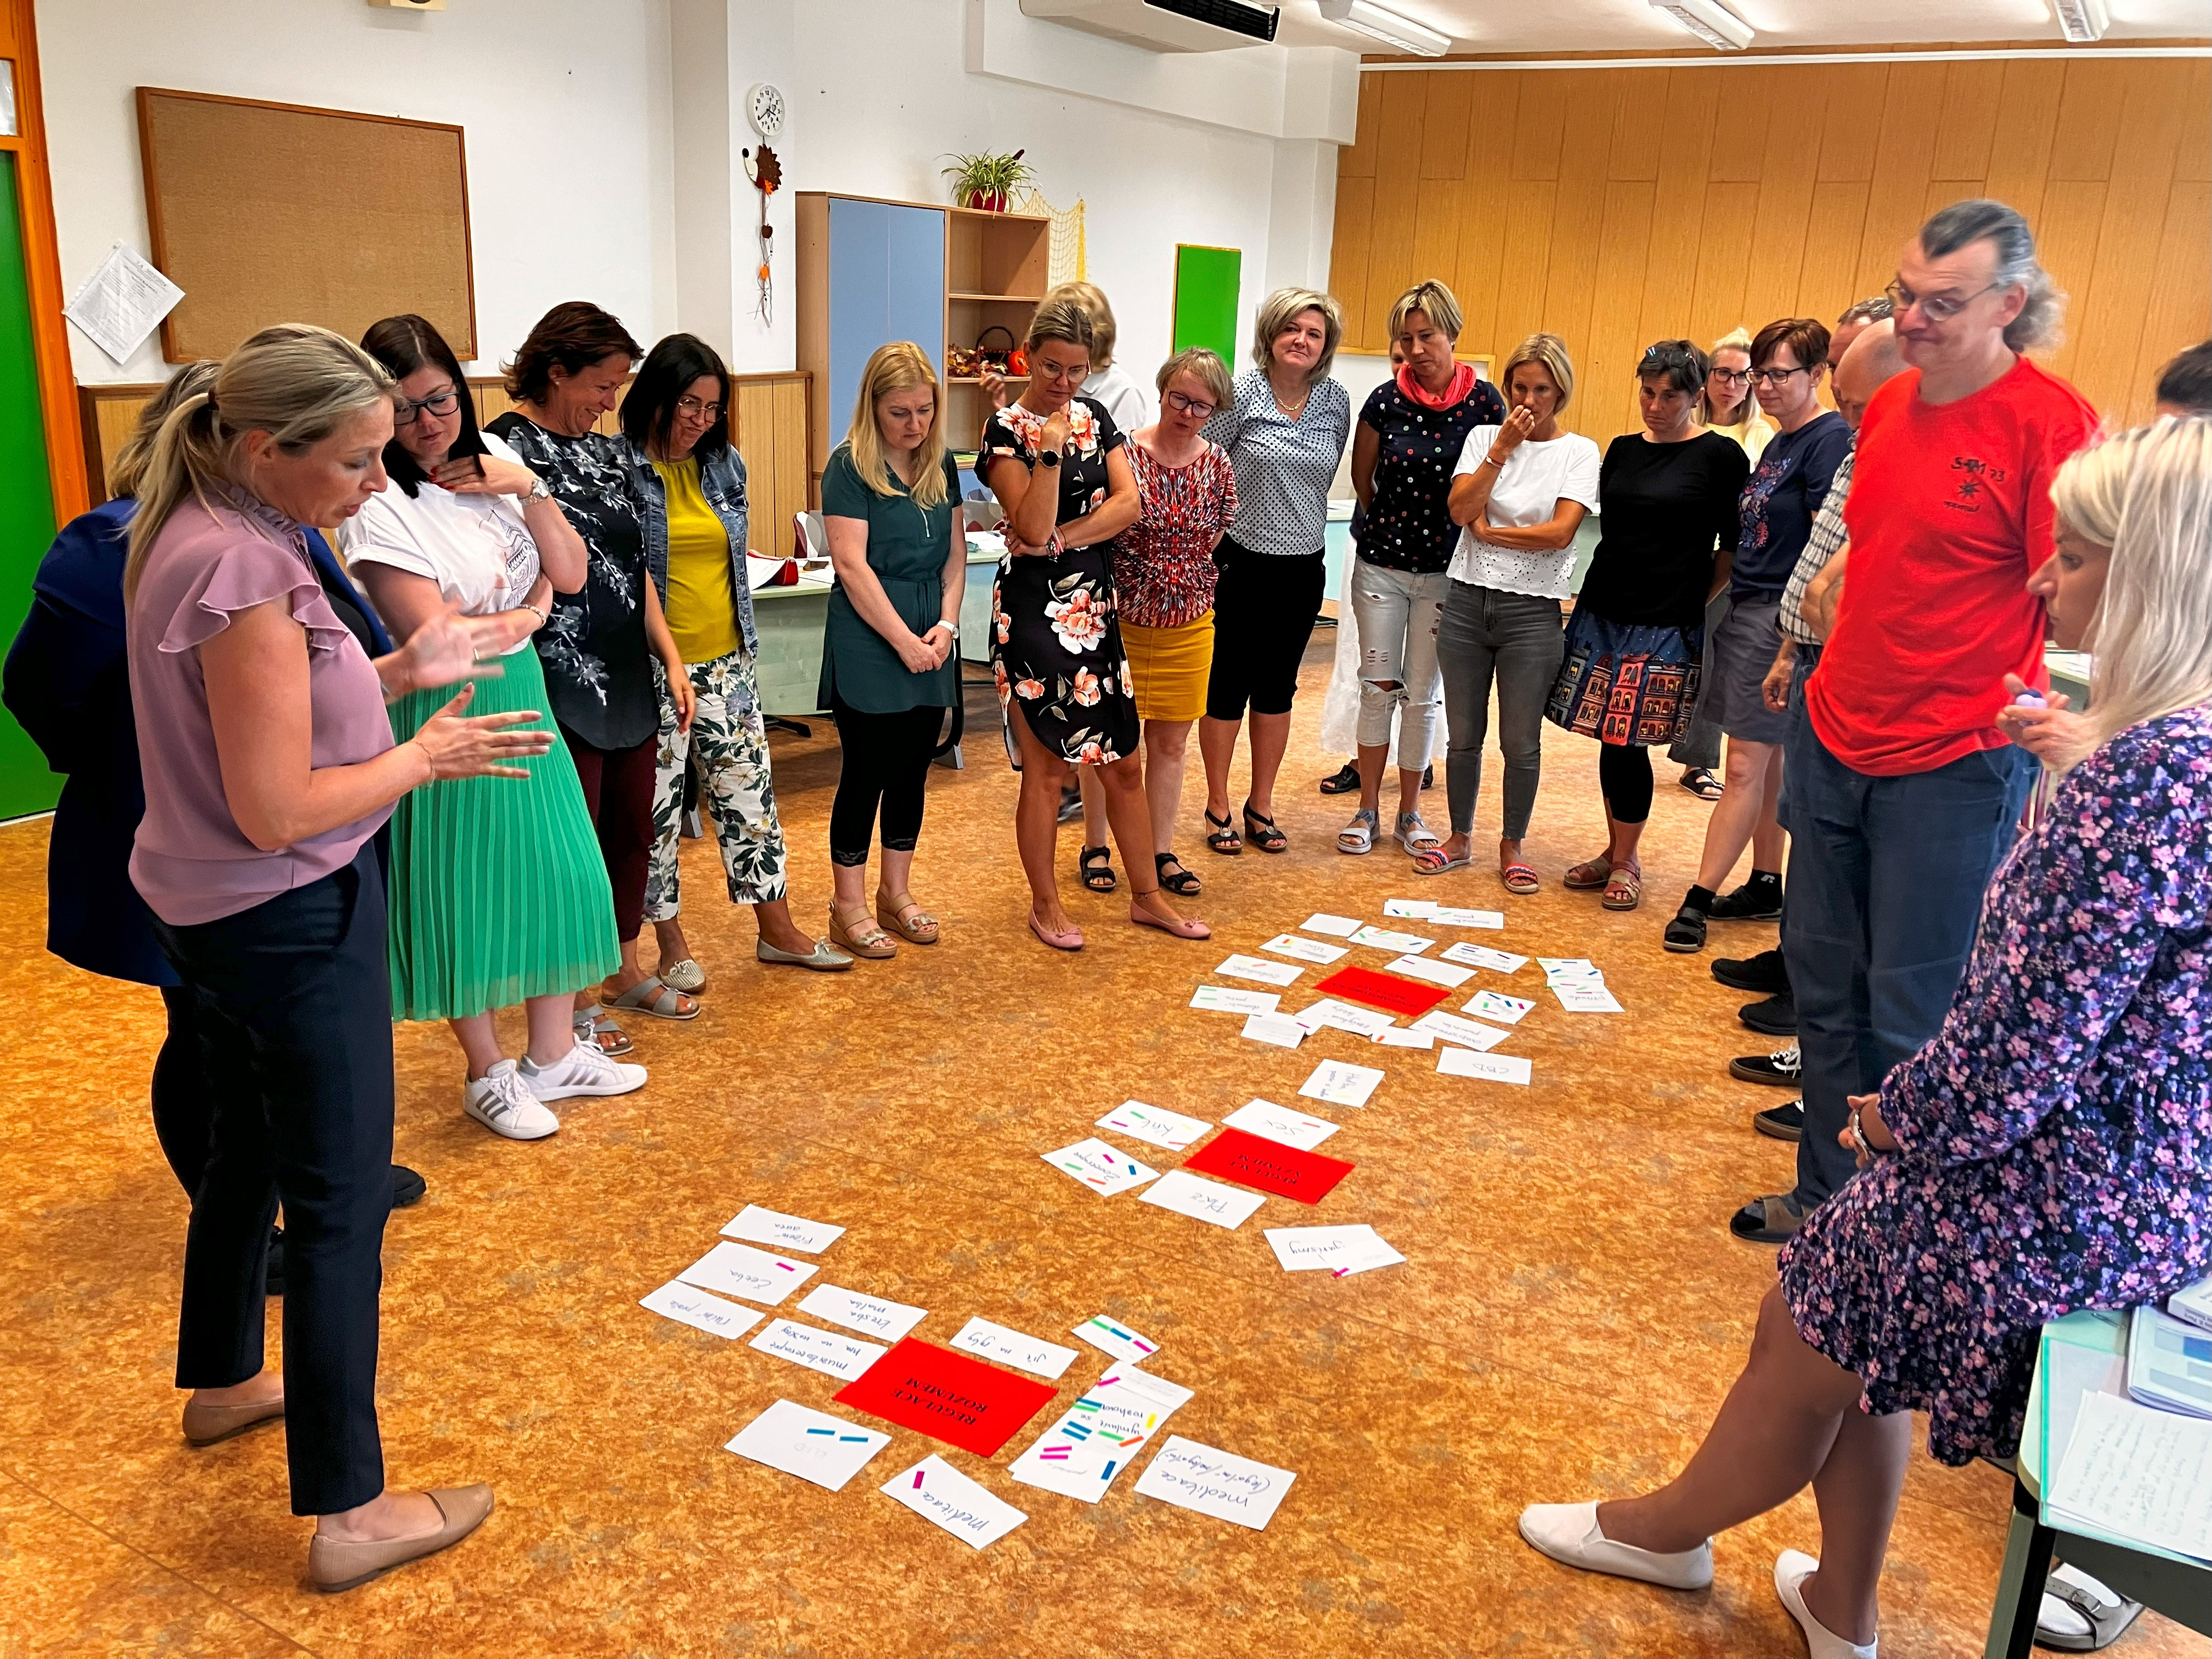
Course delivery
The lecturers received the very highest rating. Participants valued lecturers’ approachability the most (95% with an average mark of 1.09).
There were no differences either between professional background or according to the length of experience (slightly higher rating again in the category under 2 and then over 10 years in the field).

Slide 13
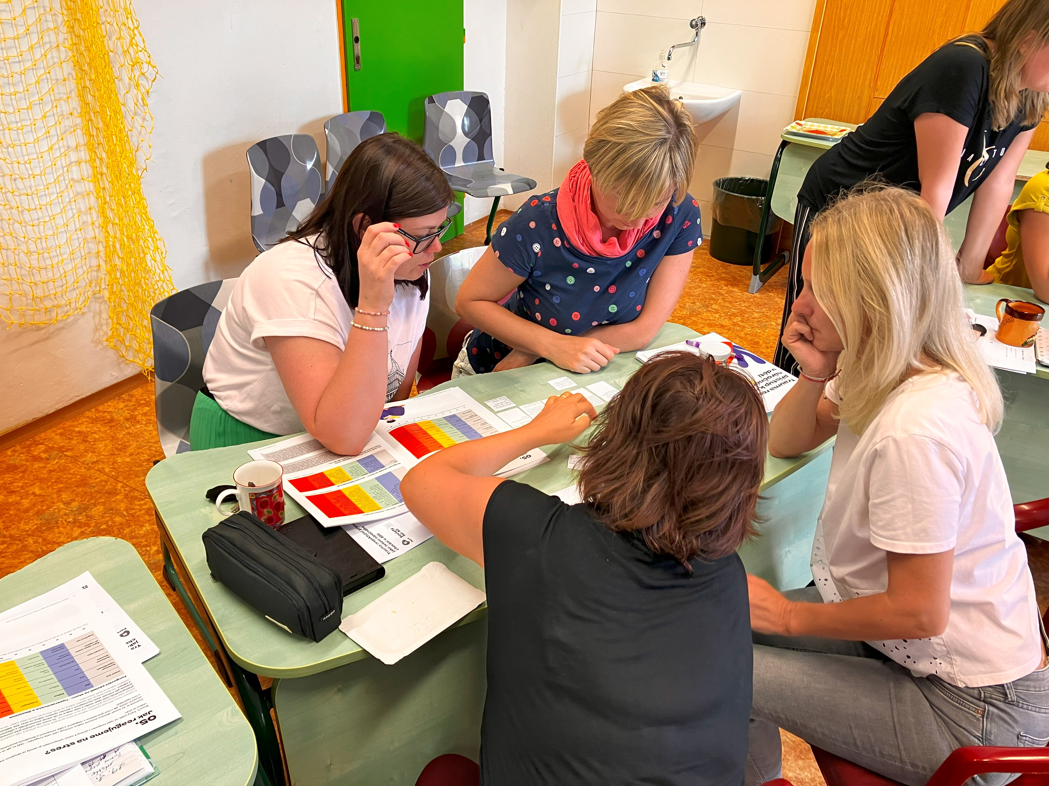
Usefulness of individual topics of the course
Causes of challenging behaviour, effects of toxic stress, states of activation of the stress response system, defence mechanisms were rated as the most beneficial, with 72% rating "1: very beneficial". However, the participants rated by a majority (at least 55%) all parts of the course. The average benefit thus ranged from 1.35 to 1.63.
Among the groups of respondents represented by at least 10 participants, the most different approach to topics was given by psychologists: Levels of regulation, co-regulation, deescalation techniques were rated above average: 1.33; 5 topics were rated worse than 2 (the least beneficial for them was the topic of Interdisciplinary Cooperation: 2.39).

Slide 15
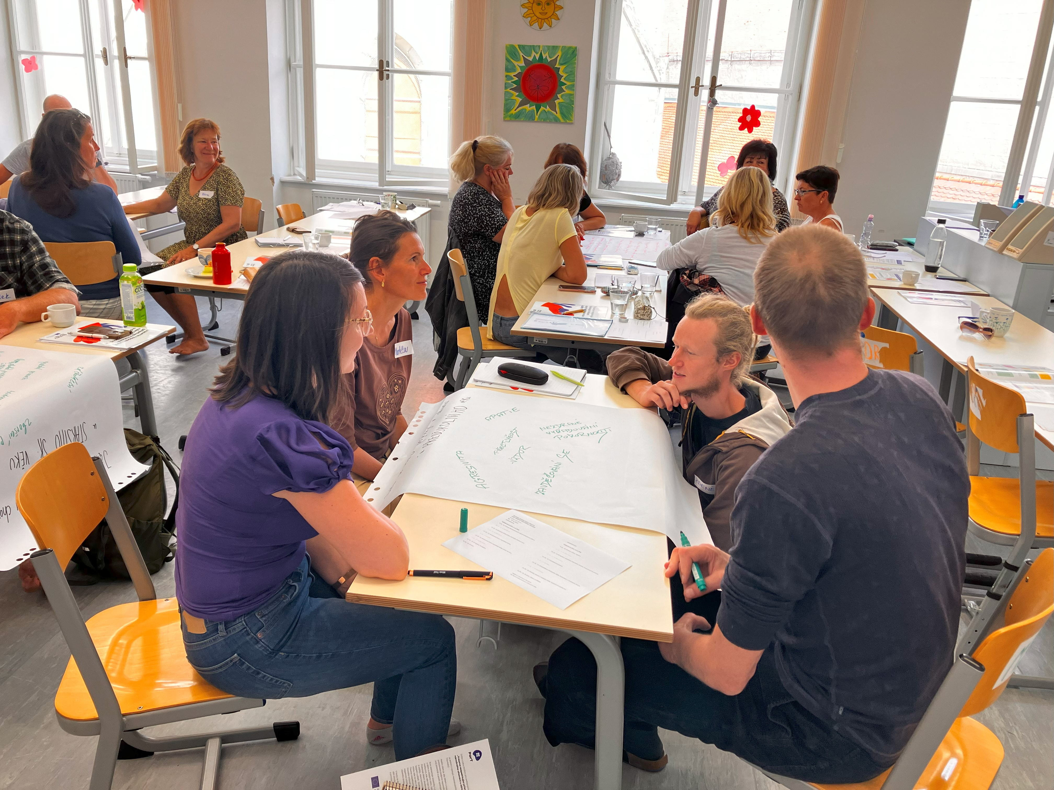
Usefulness of individual topics: educational vs social sector
The differences between educational and social sector in rating the usefulness of individual topics of the course were quite small. However, participants in educational sector found the information about domestic violence and identifying a child at risk slightly more beneficial than professionals within the social sector.
On the other hand, participants within the social sector seemed to value the information about levels of regulation, co-regulation and de-escalation techniques more than participants from the educational sector.

Slide 16
Evaluation: Pre- and Post- measures

Slide 17
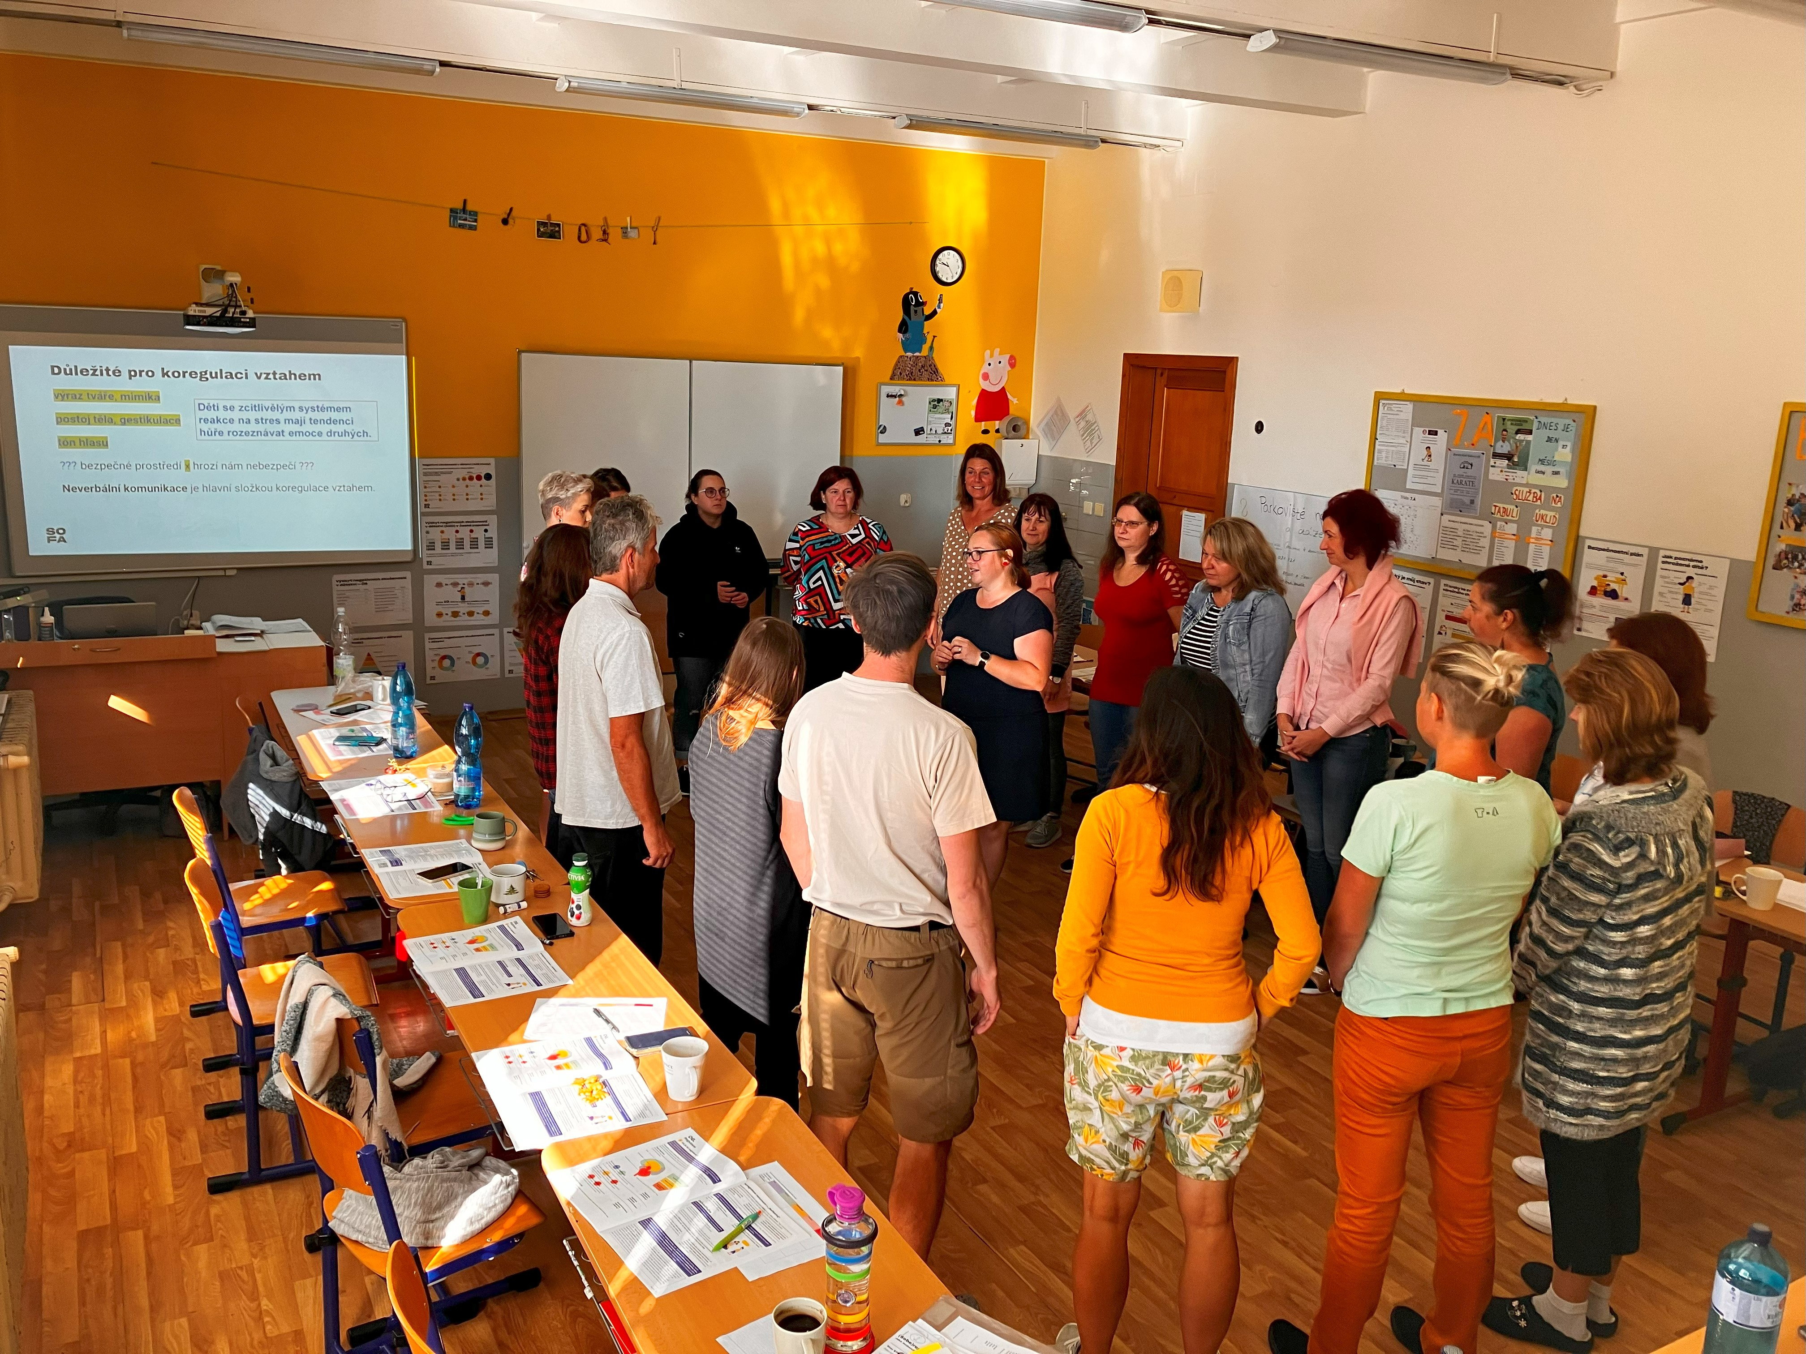
Pre- and Post- measures: the level of understanding the individual topics of the course
Participants were given 15 statements all relating to the main topics of the course content and asked to rate how strongly they agree or disagree on a scale 1 (strongly agree) to 7 (strongly disagree).
All participants were asked to rate the same statements before and after the course.
The following graphs show the percentage to which the participants agreed with the presented statements before and after the course.

Slide 21
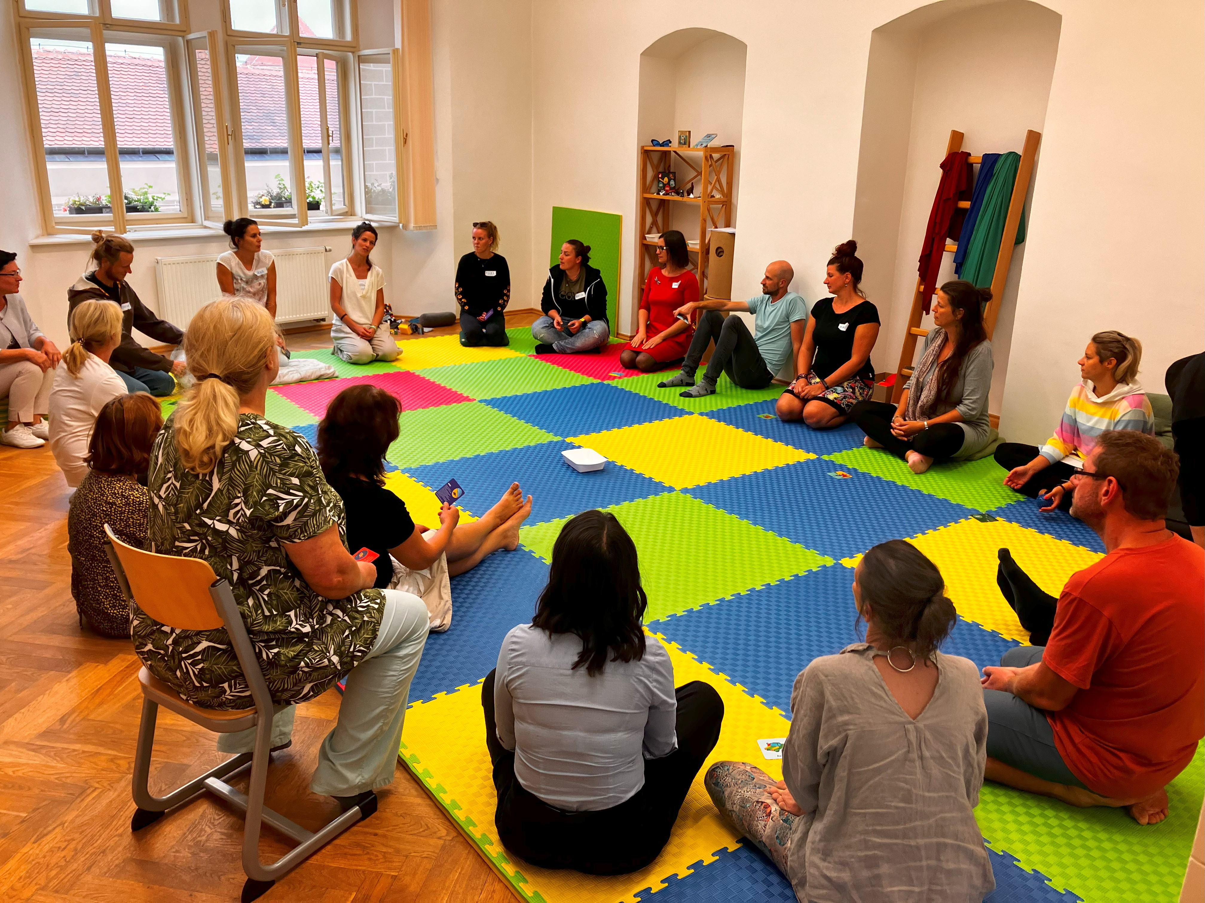
Pre- and Post- measures: the level of understanding the individual topics of the course
Participants increased their perceived level of understanding in all areas of the course content based on their agreement with the presented statements.
The biggest increase (pre- 41% post- 92%) was found in the statement “I know and can effectively use different methods and tools to support emotional regulation in children.”, followed by the statement “I know what needs to be applied when communicating with a child with challenging behaviour.” (pre- 53% post- 94%) and the statement “I have the knowledge and skills to help a child at risk (e.g. at risk of domestic violence, maltreatment, etc).” (pre- 51% post- 89%.

Slide 22
Self-efficacy scale (Křivohlavý, 1993)
Participants were also asked to complete self-efficacy scale before and after the course.There were 10 questions on a scale of 1 (disagree) to 4 (agree) which measure respondents' confidence in their own ability to effectively manage selected situations. The total score could thus take the values from 10 to 40, in real terms it ranged from 18 to 40.
2/3 of participants had an overall score of 30+: there were some pre- and post- measure differences, but not significant: a score of 30 or higher appeared in 61% of participants before the course and increased to 72% after the course. The average increased by only 1 point: from 30.7 to 31.7.
There were no major differences either by region or by broader category of profession. Only respondents from a small group, whose predominant activity so far is study, rated their abilities slightly lower before the course (27.5) than after the course (30.2).

Slide 23
Evaluation: Qualitative data

Slide 24
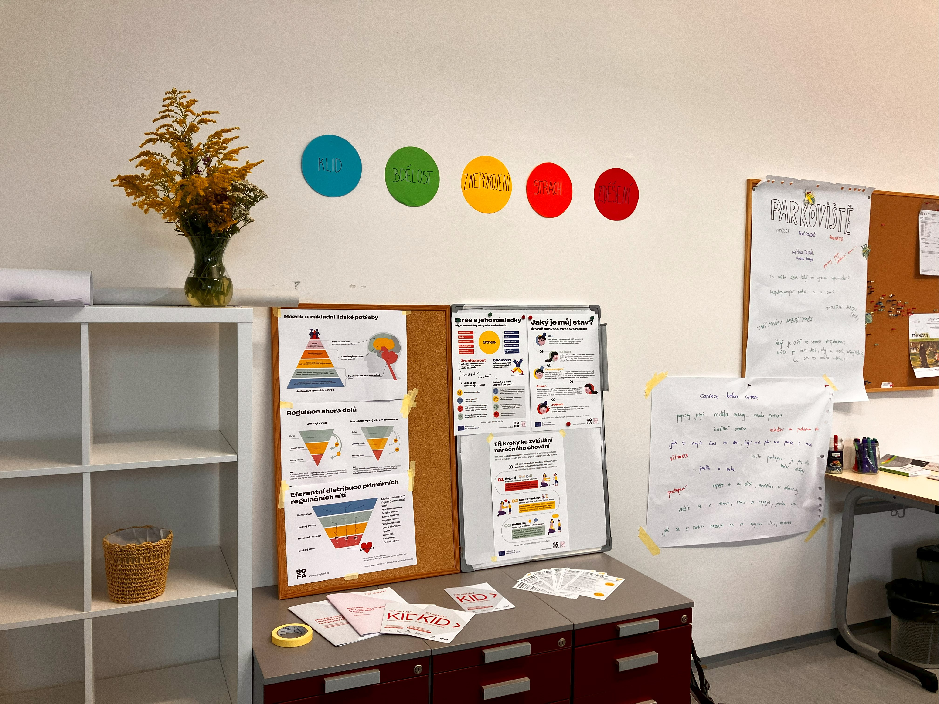
What did participants learn during the course?
„A new insight into the issue has helped me greatly - there is no such thing as a demanding child, there is just a child who has a demanding childhood.“
„ I have never looked at it from the perspective of the child, this insight was very beneficial.“
„The course helped me to view the topic more “holistically” and put together the information I knew separately into a whole.“
„This seminar certainly brought me hope that trauma can be overcome.“

Slide 25
What did participants learn during the course?
114x the participants stated the course helped them with learning how to identify a child at risk and better understand the causes of challenging behaviour
110x they highlighted the functions ofthe brain and learning about the basics of neuroscience
55x the participants mentioned they realised something new within the area of the course content
52x deescalation techniques, somatosenzory tools and activities were mentioned as something the participants took away from the course

Slide 26
What did participants learn during the course?
48x participants mentioned self-regulation and learning about different calming and relaxation techniques they can use both with children and themselves
44x they mentioned a change in perspective, an insight, better understanding of some of the topics from the course content
32x the participants specifically stated they felt they learnt more about how to communicate with a child at risk
25x was mentioned recognising the different states of stress activation system
only 20 participants out of 649 mentioned they learnt nothing new, often based on long-term professional experience and the number of courses attended in the past

Slide 27
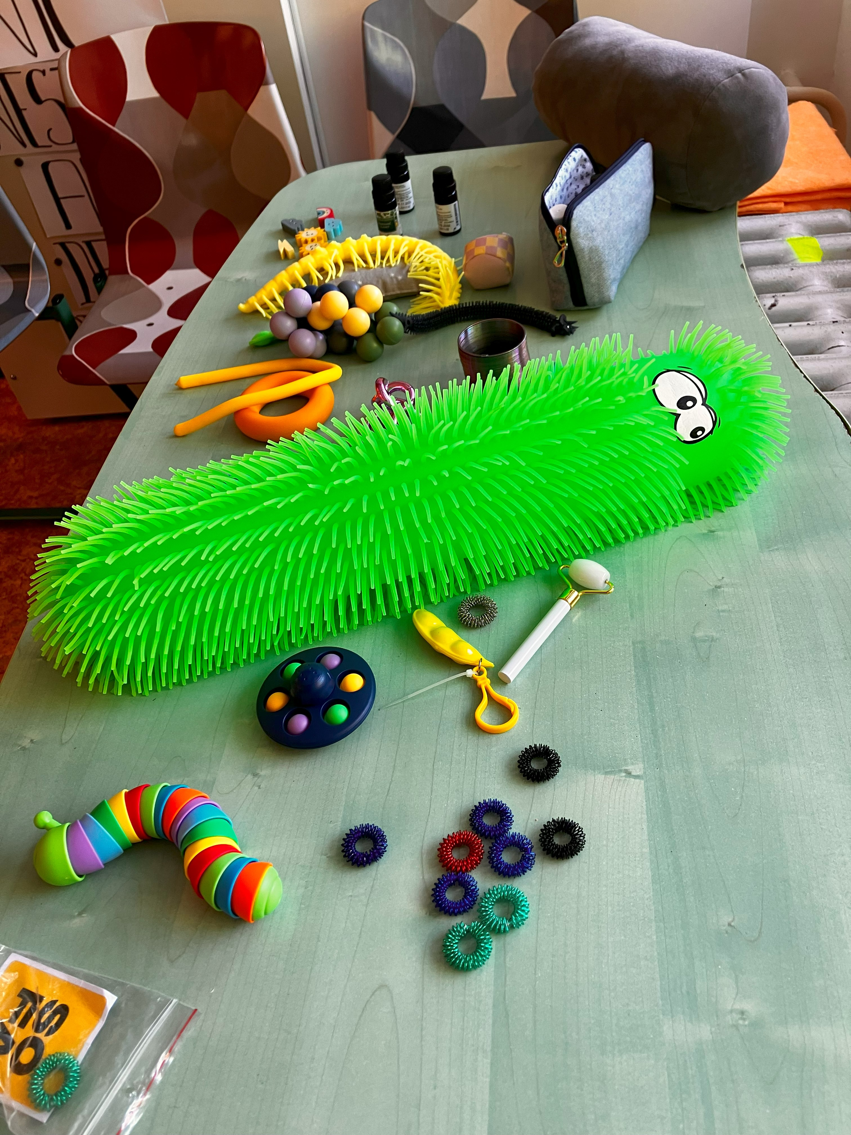
What did participants learn during the course?
„Rather than learned, I realized I am able to have greater empathy for those children with challenging behaviour, especially thanks to the activity "stickers on the picture" (which were originally all negative, but then I found also the child´s positive side) or testing somatosenzory tools (I have already recommended this to one pupil based on the course).“
„I learned both theoretical information and practical knowledge.“
„Overall, this topic was new to me. It was and will be beneficial to my work.“

Slide 28
What would support the implementation of acquired knowledge and skills into participants’ professional practise?

Slide 29
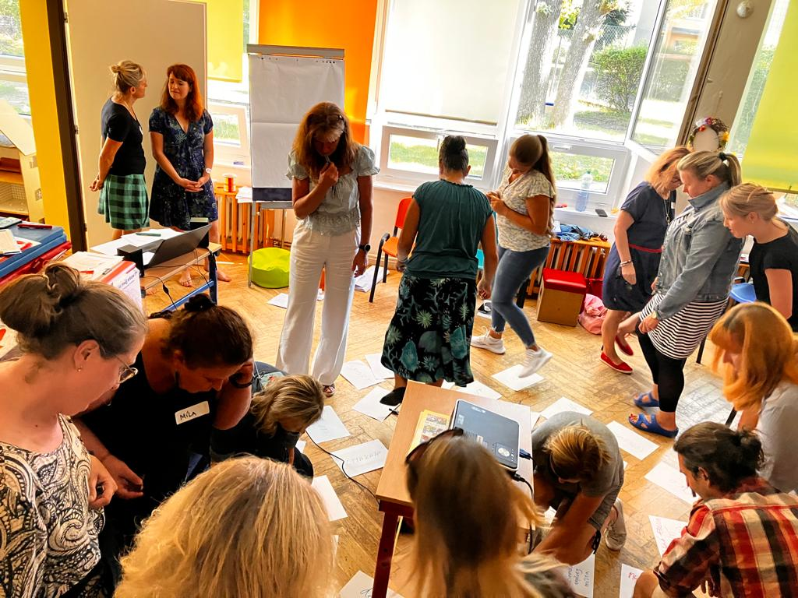
What would support the implementation of acquired knowledge and skills into participants’ professional practise?
A quarter of participants either said they had no idea or left the field open.
Participants would most appreciate even more concrete examples, samples and tips (12%), 9% would like to have more time/space to do individual work/care. 6% would like to be able to practice different situations more, the same proportion think it will improve by practice alone, 5% think it would contribute to this if they had more graduates in their workplace and have further deepening courses as a follow up.
Participants working in education rather than social services reported they would appreciate more time to do individual work or receive individual approach (10% vs. 4%). Workers in social services on the other hand, would be more appreciative of repeating information/having a bigger anchor.

Slide 30
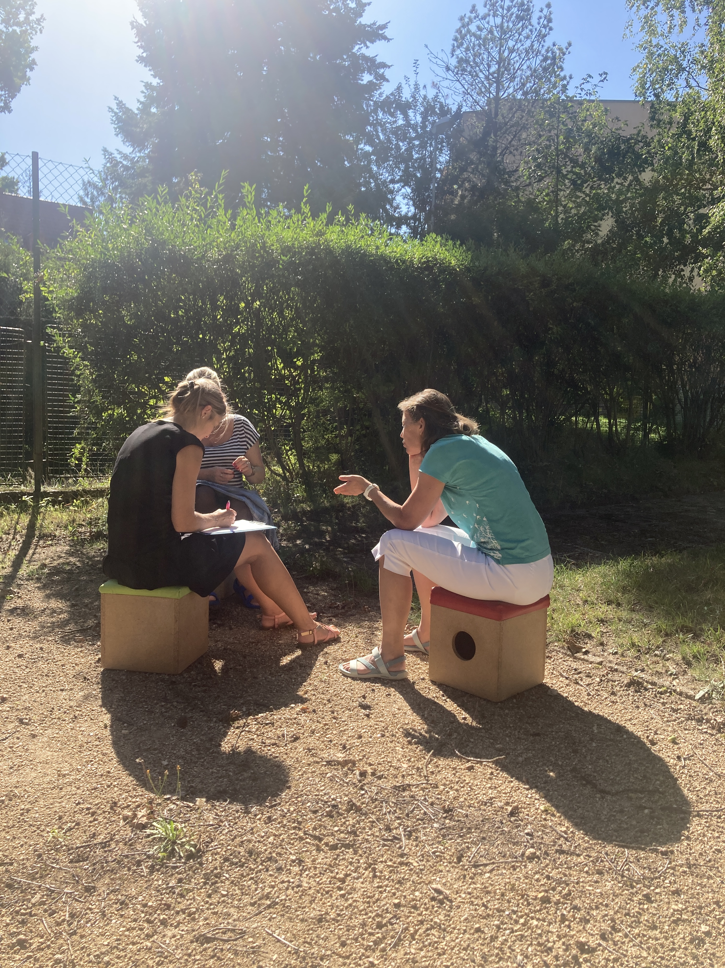
What else would support the implementation of acquired knowledge and skills into participants’ professional practise?
Some other responses included ideas like having fewer pupils in the classroom; focusing more on yourself / more space to pause and adjust
Another idea was about focusing on a specific target group, e.g. “I would like to work primarily with high school students, therefore I would perhaps welcome more examples/greater overlap with the age of adolescents”; “I work with Ukrainian children who are traumatized by war. It would help me in my work if teachers in schools knew how to work with such children”; “I work with pupils with a more severe degree of disability, therefore some of the information discussed cannot be fully applied in my practice.”

Slide 31
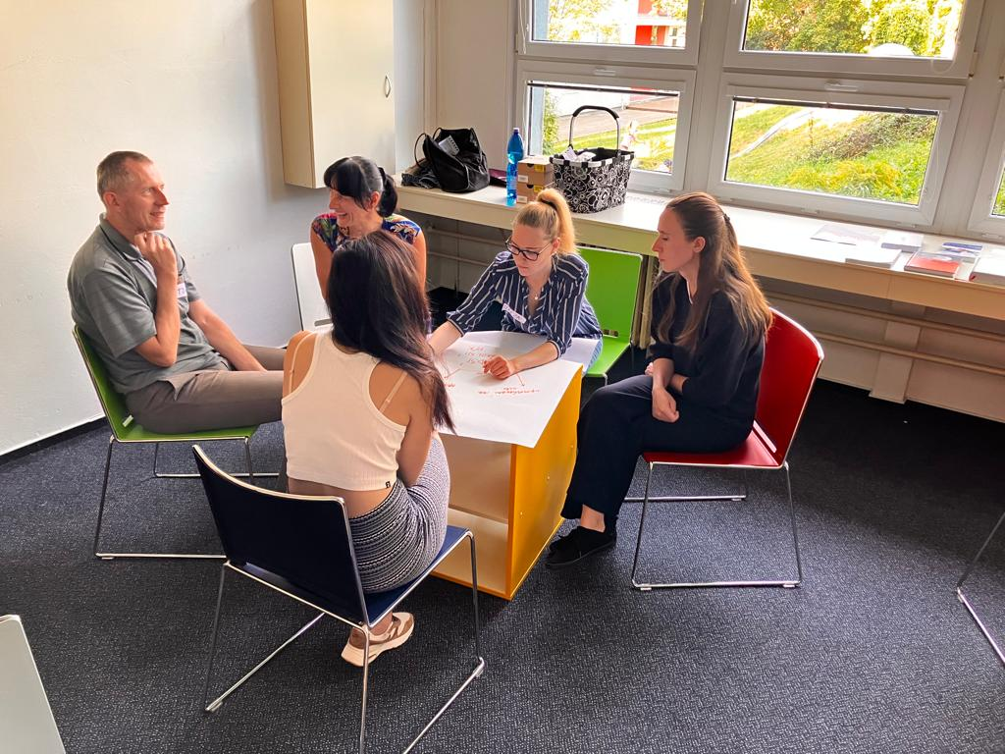
What else would support the implementation of acquired knowledge and skills into participants’ professional practise?
Further was mentioned a better cooperation with parents; the course should be longer; more public education / information; better cooperation with colleagues; need to have physical space (study, corner…); more support of surroundings; being able to recognize traumatized children; greater availability of psychologists, therapists or teaching assistants, etc.
Less often then discussed, for example, own motivation to take on the trauma-informed approach, less administration, more finance, possibility of lessons with the form teacher, etc.

Slide 32
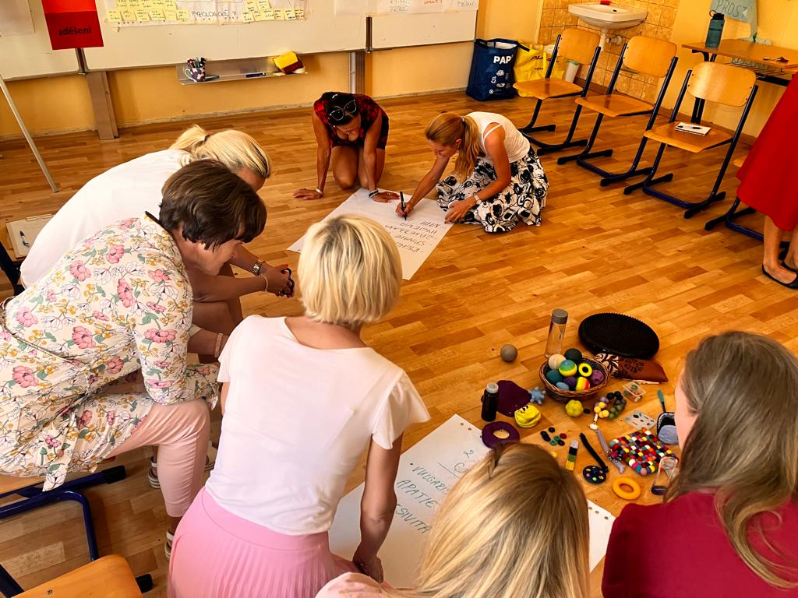
Implementation support: slight differences across sectors
Educational sector: Secondary school teachers prefer having more time (19%) over having more concrete examples (8%) as opposed to primary school teachers who prefer to have more concrete examples (15%) over having more time (11%). Primary school teachers also tend to prefer having continuous supervision (8%) a bit more than secondary school teachers (5%). Teaching assistants would prefer having more concrete examples (12%) and more practice (7%)
Social sector: Social workers would prefer to have more concrete examples and case studies (9%) similarly to teachers within the educational sector but would also appreciate more repetition and processing of the acquired information (9%). They would also welcome more practice (7%) and more time (6%).

Slide 33
What are the limiting barriers to using the acquired knowledge/skills in everyday practice?

Slide 34
What are the limiting barriers to using the acquired knowledge/skills in everyday practice?
“Difficult work with departments, where I have to devote most of the indirect activity to the preparation of educational activities and have very little time for reflection, etc.”
“Lack of time to notice all other aspects during lessons.”
“A large number of formal duties = the teacher himself is in a stressful environment.”
“A large number of children in the classroom and the demands placed on the teacher.”
“I think it depends a lot on the environment and the management of the school. In some schools it is difficult to apply these methods if they have a different approach to the pupils overall and, for example, they don't give the educator space with the children to discuss certain matters thoroughly and respectfully and they don't have quality interdisciplinary cooperation.”
“Lack of time, complicated administration, complicated cooperation with social services; ineffective way of sharing information from and to other parts of the system.”
The above graph presents a summary of two questions: the first general one: whether there are any barriers (it turns out that for more than ¾ participants there are not) and the additional question for those who have checked that there are; to name the barriers.
Among the workers from Social Services, 17% reported some barriers, while 25% workers reported in education.
The most common barrier is lack of time, especially in education (8%, while 3% reported it in social services). The mentioned aspects, the size of a class or the number of clients, are probably related to time, but were specified as follows:

Slide 35
Selected limiting barriers across sectors

Slide 36
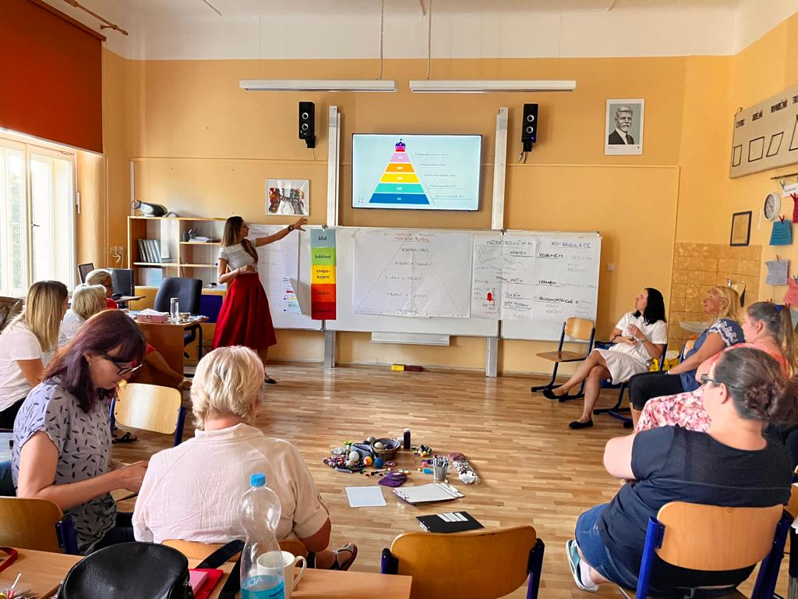
Selected limiting barriers across sectors
In social sector there is much less perceived barriers to implementing the knowledge and skills from trauma informed approach course than within the educational sector.
The main selected barrier was time. In social sector it is perceived to be a barrier in only 6% (4% social workers and 2% assistant social workers) of participants whereas in educational sector it is perceived a barrier by 28% participants (12% elementary school teachers, 11% secondary school teachers and 5% special education needs teachers).

Slide 37
In what way do you think the system of care for children at risk needs to be strengthened most in the Czech Republic?

Slide 38
In what way do you think the system of care for children at risk needs to be strengthened most in the Czech Republic?
The open question on the possibilities of improving the care of at-risk children brought almost a thousand suggestions. The most frequent ones mentioned the need for cooperation and awareness among the individual subjects who deal with these children: from schools, through social services to the police (23%).
The key, according to the participants of the course, is especially increasing the education of educators, but also of any other workers who come into contact with the children (17%).
According to a large part (14%), general promotion and awareness of this issue among the public, including the mediation of cases, is also important.
Very often the personnel question was also mentioned, sometimes very generally, in the sufficiency of qualified staff, in the end there were specifically assigned (child) psychologists and therapists and school psychologists. Several times there was also a need for the position of school social educator, but not so often.
In addition to the chart, there were more frequent repetitions: greater competence of social services; support of organizations, the system (network across the Czech Republic); staffing reinforcement of social services; finances (in general, but also financial accessibility of services for everyone in need or, on the contrary, well-paid professionals); reinforcement of substitute family care or follow-up care (upon discovery); reduction of administrative and other burdens and, conversely, having more time for individual work with pupils; toughening of penalties (probably included in the answer "legislation") or also care for carers.

Slide 39
Importance of the selected themes across sectors:

Slide 40
In what way do you think the system of care for children at risk needs to be strengthened most in the Czech Republic?
Social services related:
“Awareness that social services help, to get rid of prejudices, to raise awareness of the possibility to turn to non-profit organizations - Rosa, Locika, to increase the awareness and sensitivity of educators on this topic, to change the thinking of some educators - to educate, educate faculty rooms, to get the topic in magazines, podcasts, interviews.”
“Certainly - in the number of social services staff, I also think it would be very helpful to have more field staff knowledgeable about this information and the possibility of their intervention in families that are in need are critical. Also, to teach this at the faculties of education, to gradually train all the teaching staff from kindergarten and elementary school to secondary school.”
“More funding of social services so that there are quality, motivated workers, more support for social services and not splitting their competences as happens in recent novels, strengthen interdisciplinary cooperation.”

Slide 41
In what way do you think the system of care for children at risk needs to be strengthened most in the Czech Republic?
Interdisciplinary cooperation related:
“Interdisciplinary cooperation and leaders of the topic who sponsor it and respectfully to time management of all actors initiate and lead meetings; multidisciplinary cooperation in practice, e.g. mobile multidisciplinary team in case of schools that do not have funding or enough quality applicants to expand their own school support system.”
“There is a difference in the functioning of individual social service and the whole system is not interconnected. Writing repeated messages to endangered children takes a large amount of time. The child is in danger, the school writes reports and for months nothing happens.”
“Probably legislation so that there are not so many children in institutions, but they can go to families. more help from the state to vulnerable families and education. Social services system.”
“Financial support from the state (mainly organizations such as Klokánek), greater cooperation of various organizations and social services, greater concern for children's well-being, even at the expense of suppressing the rights of the parent, trust in the victim.”
“Personnel and financial: evaluation of staff, especially preventive services. Uniting under one ministry, or interdisciplinary coordination.”

Slide 42
In what way do you think the system of care for children at risk needs to be strengthened most in the Czech Republic?
General:
“I have the feeling that children in secondary schools are just being forgotten, because there is probably a presumption that problems in families de facto appear at a younger age and are already solved.”
“Connecting all institutions, more specialists and doctors, more regular cooperation with doctors, more timely help from all specialists, more education in schools, putting and directly with pupils install links to first aid lines on their mobile phones, sending all children links to first aid lines on their mail. Overall, strengthening the system of aid for all specialists: more flexible, more effective, more real. Everyone knows the theory, they have all the help written down, but they don't know how to help in time. It would be great if prevention really worked in all schools, and if every school had its own school psychologist.”
“And what is very important is that in all these fields workers are educated. This topic is very difficult and therefore we need to approach it with the most empathetic approach - which unfortunately we do not always encounter in practice. Unfortunately, the poor and brutal approach of the worker can hit the child and strengthen the trauma or experience. It's all in the people, it's not just about the system. Regular education is very important for me, whatever it is, whether it's within lectures or self-education. Even a sensitive and empathetic approach can be partly learned - but this comes after understanding the problem and the individual with whom the worker is working.”
“Setting up an effective link between professionals involved in supporting children at risk, setting up procedures for sharing information (e.g. to avoid secondary victimization of the child by repeating his or her experiences). Probably also greater awareness of myths and generally the topic among the general population.”

Slide 43
Ideas for future improvement of the course

Slide 44
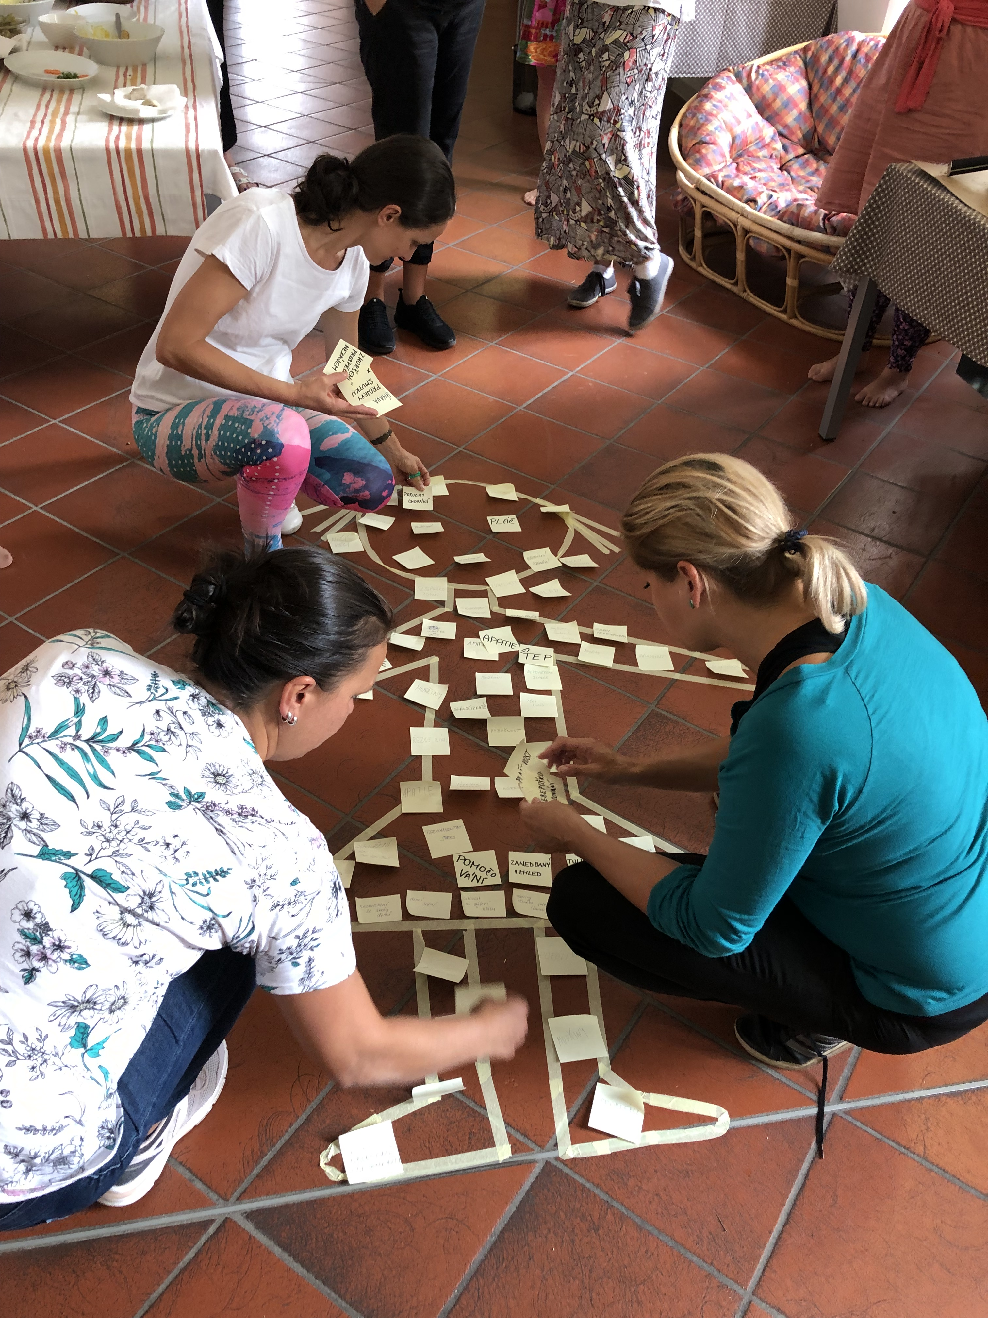
Ideas for future improvement of the course:
Comments on the course were mostly praise and positive.
The possible suggestions for improvement related to:
More examples from practice (lecturers themselves, real situations solved by participants…)
“More practical exercises and their reflection, involvement and "weaker" traumatic situations. It doesn't have to be about violence or abuse etc.”
“The course is great, I would put more "sketches" of practical training, but I know that it doesn't meet the will of most trainees.”
“I propose to extend module 4 (even at the expense of module 1) with practical training of model situations and subsequent analysis.”
“I would include more knowledge from the practice of the lecturers themselves in the course so that we can see directly on a specific case how to solve the situation.”

Slide 45
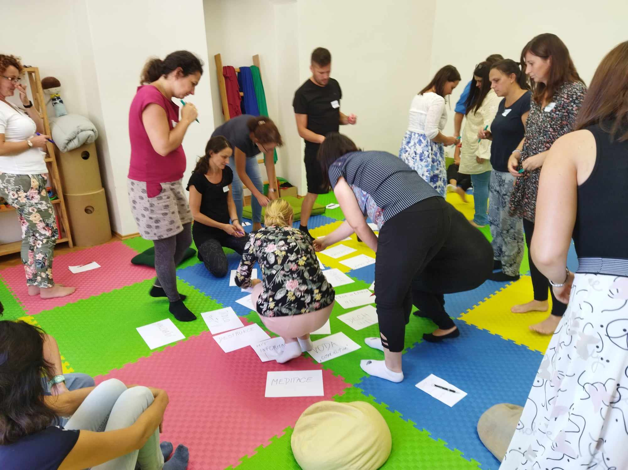
Ideas for future improvement of the course:
Length of the course: some participants wanted to extend the course (e.g. share their own experiences), but some would shorten it. There were also replies that it would be more appropriate to divide the course (albeit with the same time subsidy) into more blocks.
“I can’t think of anything, in two days there is no more information to pass on. If the course was longer, it would be possible for the participants to share their experience more, to ask the lecturer and the participants about their own specific situations from practice.”
Less work in teams / groups (but even here, on the contrary, some participants would appreciate to increase this part)

Slide 46
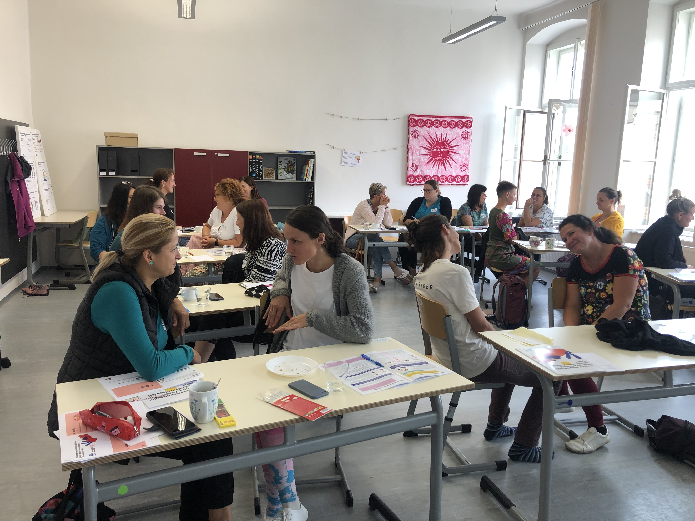
Ideas for future improvement of the course:
There were also several comments that came from a specific target group (e.g. already greater knowledge of the topic among social workers, on the contrary, a demand for more focus on social services, an incentive to divide the course for individual groups, etc.)
“I would welcome videos and examples from the field of social work rather than from education. I would be better able to visualize these situations, techniques and methods of work in my work. This would perhaps also help me to put them into practice and then make better use of them in practice.”
“The course is designed for teachers in primary school, for special school it should probably be prepared differently.”

Slide 47
Would you recommend this course to your colleagues?

Slide 48
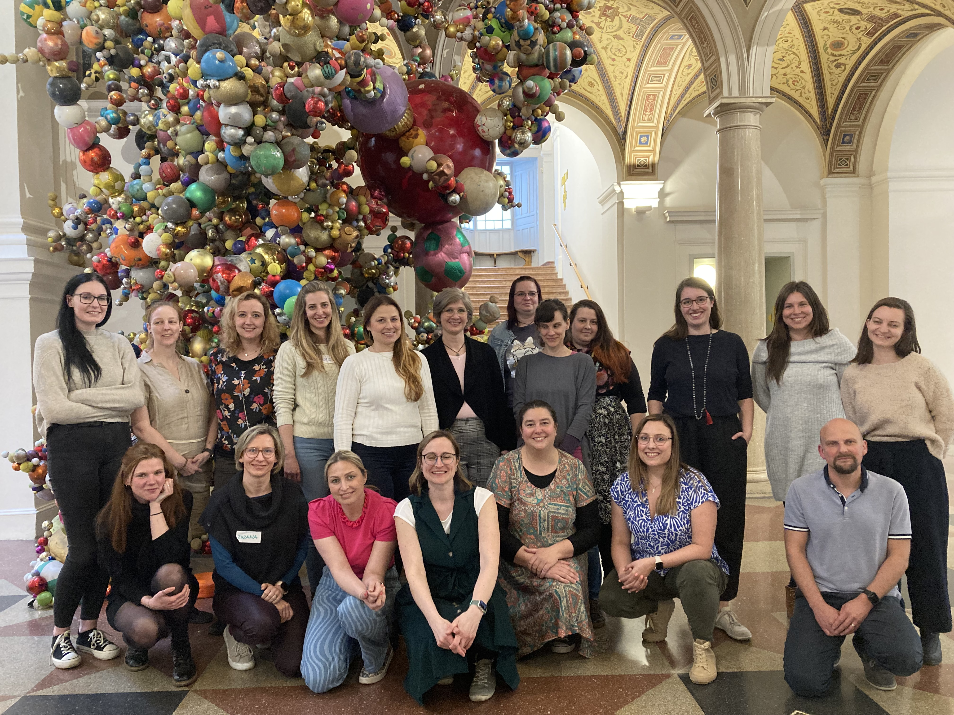
Would you recommend this course to your colleagues?
The vast majority of participants (84%) would recommend SOFA training services to their colleagues as well. 63% said they would definitely recommend and 21% would recommend (rated 9 or 8 on the scale).
Average recommendation rate:
Education: 8.77
Social services: 9.14
Overall: 8.90.

Slide 49

Outcome mapping results

Slide 50
What is Outcome mapping?
Outcome mapping is a methodology used to plan, monitor, and evaluate programs, focusing on changes in behavior, relationships, actions, or activities of directly involved stakeholders rather than solely on broader impacts.
In the framework of outcome mapping, "boundary partners" are identified as the individuals, groups, or organizations that a program interacts with directly and can realistically influence. These partners are crucial because the program's success is measured by the changes observed in these stakeholders.
The concept of "outcome challenges" refers to the specific, desired changes in behavior or relationships among these boundary partners that the program aims to achieve.
„Progress markers“ are a key tool in outcome mapping, serving as specific indicators used to assess changes in the behavior, relationships, actions, or activities of boundary partners. They are essentially benchmarks that help to measure how far along boundary partners are in achieving the outcome challenges set by a program.

Slide 51



In outcome mapping, progress markers are often categorized into three levels that reflect the depth and complexity of changes observed among boundary partners:
(1) Expect to See: These are the most immediate, observable changes that are relatively easy to achieve. They indicate the first signs of progress and are often essential steps toward more significant transformations;
(2) Like to See: This level represents more substantial changes that are desirable but not absolutely necessary for the success of the program. These progress markers involve more significant shifts in behavior and deeper engagement, such as consistent application of new skills, regular collaboration with others, or increased leadership in initiatives;
(3) Love to See: These markers describe the most advanced and profound changes, representing ideal scenarios where the highest aspirations of the program are realized. Outcome mapping is a methodology used to plan, monitor, and evaluate programs, focusing on changes in behavior, relationships, actions, or activities of directly involved stakeholders rather than solely on broader impacts.
Note: The evaluation methodology used in project PorT (ITIEC) does not represent the full version of outcome mapping, it is rather inspired by it.

Slide 52
Outcome mapping results
The project evaluation report was prepared with the following purpose:
To assess the impact of the project outputs on the professionals' understanding of TIA and the ability to implement TIA into their work with children, strengthening the system of supporting children at risk in the Czech Republic.
To create a basis for further work of the implementation team even after the end of the project realization (sustainability).
Realized project activities:
Establishment of core project teams needed for successful project implementation.
Development of training materials and training methodology.
Training of (at least) 58 regional trainers across all 14 regions within the Czech Republic.
Training of (at least) 1120 professionals in education and social services working with vulnerable children.
Dissemination of project outputs to Visegrad region.
Counselling service of the Institute for Trauma Informed Education and Care.
All necessary project outputs were produced and delivered during the project duration.

Slide 53

The assessment is based on the following sources and inputs:
Review of project documentation and records.
Individual interviews.
Review of project documentation and records
The Grant Agreement.
The project outputs.
Outcomes of the Pre- and post- evaluation.
Individual interviews
Individual interviews conducted with the aim to identify:
stakeholder awareness of project outputs.
stakeholder attitudes towards project objectives.
the enablers of the project outcomes.
the barriers of the project outcomes.

Slide 54

The respondents were interviewed in the form of an empathy interview.
The interview structure:
Q1: In your opinion, is socio-emotional learning a part of the educational content of pupils and students?
Q2: Have you noticed a project to support the dissemination of a Trauma Informed Approach amongst professionals in education (and social/health services) (PorT)?
Q3: Did you know that SOFA is active in this area?
Q4: What could you do from your position to spread these approaches?
Q5: Do you see any barriers to the use of TIA in the education and social sectors?

Slide 55
The selection of respondents:
Thanks to different projects and activities (especially the Signals project), SOFA is very well networked in many regions of the Czech Republic. Therefore, the contacts with which the organization has been cooperating for a long time were used. The management of the organization is also involved in commenting on legislation related to the areas of education and protection of children at risk (the president of the organization is an Adviser to the Minister of Education, Youth and Sports). The SOFA advocacy team communicates with parliamentarians and officials of responsible ministries and other related institutions.
In addition to these contacts, officials who do not work with SOFA were contacted to obtain a variety of responses. It is the responses of these individuals that are an important source for us in the future as they represent the views of those who are less informed about the needs of children at risk.

Slide 56

Overview of conducted interviews:
Stakeholder/Boundary partner levels
Government level - Ministries
MEPs
Regional authority officials
Municipal authorities
School principals
Teachers and social workers
Trainers (of the project outcomes)
Agency for Social and Legal Protection of Children
Universities
Special education centres
National Pedagogical Institute
Local action groups
NGOs

Slide 57
Evaluation background
The project defines its own mission and overall goal as follows:
“We create conditions for children with traumatic experiences to receive support in schools and other institutions to help mitigate the effects of trauma. This is why we have created PorT - Understanding Trauma.”
In terms of good practice, effective use of project outputs and achievement of the objective, the following general assumptions were identified:
Outputs are based on latest knowledge and expert insight into the situation and needs of children at risk in the region, evidence-based methodology, suggestions of supervision teams, peer group and users of project outputs.
The lecturers should be carefully selected and professionally qualified. To ensure local knowledge of local organizations supporting children at risk, they should represent all regions of the Czech Republic.
The project outputs should be piloted and adapted based on the feedback of the participants of the training.
The participants should fully understand the benefits of the project outputs and its added value for their own well-being.
The educational materials should be visually attractive (for adults and children).
The participants should get a general knowledge of the possibilities of the interdisciplinary cooperation and competences.
The solutions and approaches offered should not be costly.
There is a need to spread awareness of the basic principles of a trauma-informed approach to encourage general public to use it and find out more.
Advocacy work is necessary to promote systemic changes.
There is always a need to assure that in project implementation, inappropriate solutions can be identified early and quickly.

Slide 58
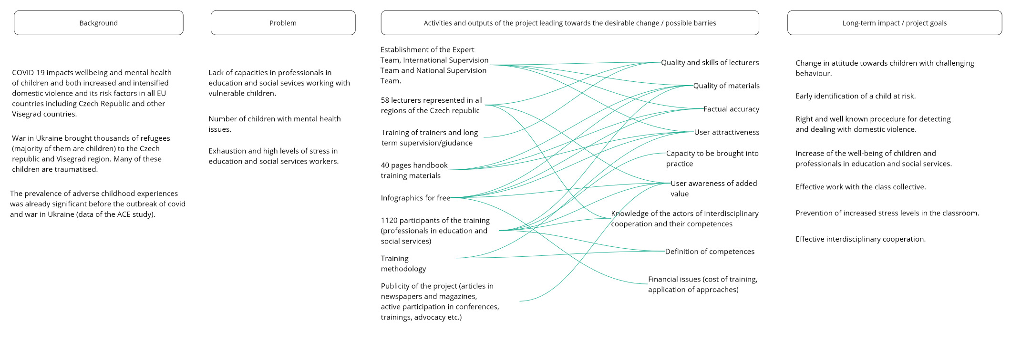
Table 1: Theory of change

Slide 59



Boundary partners
Stakeholder/ Boundary partner | Outcome Challenge | Progress Markers
Ministry of Education, Youth and Sport, Ministry of Labour and Social Affairs | Plays a key role in drafting legislation and implementing systemic change. Grant accreditation of training (especially important for the social workers). Financial support the training delivery. Monitor the implementation and provide supervision and evaluation support. |  | Are aware of the need to support children at risk. Support and create positive systemic change in support of children at risk. Know the basics of TIA. Spread awareness about TIA at meetings. Push for systemic change to support children at risk. Look for ways to financially support the care of children at risk. Advocacy themes in strategic documents and laws.

Slide 60
Boundary partners
Stakeholder/ Boundary partner | Outcome Challenge | Progress Markers
MEPs | Play a key role in drafting legislation and implementing systemic change. Provide platform for international and multidisciplinary cooperation. |  | Are aware of the need to support children at risk. Vote for positive change in support of children at risk. Inclusion of topics on the agendas of the Education and Social Affairs Committees. Spread awareness about TIA at parliamentary meetings. Advocacy themes in strategic documents and laws.

Slide 61
Boundary partners
Stakeholder/ Boundary partner | Outcome Challenge | Progress Markers
Regional authorities and municipalities (In a few cases they could be the founders of primary schools.) | Are fundamental to the development of regional action plans and long-term plans that influence the approach to children's mental health and child at risk issues across the region. Are an important partner in the dissemination of information towards primary school founders, social workplaces and other institutions. Play a key role in the development of interdisciplinary cooperation in the region. |  | Are aware of the need to support children at risk. Support and create positive systemic change in support of children at risk. Know the basics of TIA. Spread awareness about TIA at meetings: organize conferences and events for the heads of education departments, representatives of school founders and school founders. Push for systemic change to support children at risk. Look for ways to financially support the care of children at risk. Advocacy themes in strategic documents and laws. Implementation of SOFA activities into long-term plans

Slide 62
Boundary partners
Stakeholder/ Boundary partner | Outcome Challenge | Progress Markers
Municipal authorities (Founders of primary schools. Appoint and dismiss primary school principals.) | Their role is crucial for the support of interdisciplinary cooperation and establishment of a coordinator of the interdisciplinary cooperation. Support schools in the implementation of trauma-informed approach |  | Are aware of the need to support children at risk. Support and create positive systemic change in support of children at risk. Know the basics of TIA. Spread awareness about TIA at meetings. Support interdisciplinary cooperation. Establish and support a coordinator for interdisciplinary cooperation. Support outreach mental health support.

Slide 63
Boundary partners
Stakeholder/ Boundary partner | Outcome Challenge | Progress Markers
School principals | They are actively seeking for the ways for interdisciplinary cooperation. Implementation support of the teachers. Develop whole-school approach to the implementation of TIA. Allow resources to the teachers. Seek for resources for external support. |  | Are aware of the need to support children at risk. Support the safe school environment. Support interdisciplinary cooperation. Know the basics of TIA. Support teachers in the implementation of TIA. Allow and support whole-school approach to the implementation of TIA. Seek long term support by the team of trainers.

Slide 64
Boundary partners
Stakeholder/ Boundary partner | Outcome Challenge | Progress Markers
Teachers and social workers | Use TIA during their work with children. Create safe environment. Are well oriented and actively engaged in interdisciplinary cooperation. Offer somatosensory aids and regulation activities during their work. Monitor children’s emotional state. Take part in child protection case conferences. |  | Are aware of the need to support children at risk. Create safe environment. Know the basics of TIA. Download infographics and display it in the classroom / work office. Participate in a short TIA on-line training by SOFA. Participate in the TIA SOFA PorT training. Actively use TIA during the classes and work with clients. Are well oriented in interdisciplinary cooperation.

Slide 65
Boundary partners
Stakeholder/ Boundary partner | Outcome Challenge | Progress Markers
Trainers (of the TIA PorT training) | Create safe environment during trainings. Enable participants to ask questions and discuss important topics. Deliver the content of the training and incorporate the specific needs of participants. Are familiar with the possibilities of interdisciplinary cooperation in their region and actively share such information during the training. Make the training interactive using different activities. Incorporate different regulation activities and somatosensory aids. |  | Have a deep understanding of trauma-informed approaches. Create safe environment at their courses. Are familiar with the possibilities of interdisciplinary cooperation in their region. Disseminate information about TIA in their region. Spread awareness about TIA among their contacts and during various events. Guide course participants through the introduction of TIA on a long-term basis.

Slide 66
Boundary partners
Stakeholder/ Boundary partner | Outcome Challenge | Progress Markers
Agency for Social and Legal Protection of Children | Uses TIA during their work with children and their parents. Creates safe environment. Is well oriented and actively engaged in interdisciplinary cooperation. Organizes child protection case conferences. Offers somatosensory aids and regulation activities during their work. Monitors children’s emotional state. |  | Is aware of the need to support children at risk. Supports and create positive systemic change in support of children at risk. Knows the basics of TIA. Spread awareness about TIA to schools and among families they work with. Disseminates the infographics and project outputs at schools and other institutions. Recommend outputs of the project (materials, training) and SOFA activities.

Slide 67
Boundary partners
Stakeholder/ Boundary partner | Outcome Challenge | Progress Markers
National Pedagogical Institute, Czech School Inspection | Spreads awareness about TIA within the area of professionals in education sector. Connects TIA trainers with school staff across all regions of the Czech Republic. Disseminate project outputs during their school visits. |  | Is aware of the need to support children at risk. Supports and create positive systemic change in support of children at risk. Knows the basics of TIA. Spreads awareness about TIA among schools. Supports interdisciplinary cooperation. Recommends activities of SOFA in their annual reports, thematic reports and methodological guidelines.

Slide 68
Boundary partners
Stakeholder/ Boundary partner | Outcome Challenge | Progress Markers
Special education center | Use TIA during their work with children and their parents. Creates safe environment. Is well oriented and actively engaged in interdisciplinary cooperation. Offers somatosensory aids and regulation activities during their work. Monitors children’s emotional state. Takes part in the child protection case conferences. |  | Is aware of the need to support children at risk. Supports and create positive systemic change in support of children at risk. Knows the basics of TIA. Spreads awareness about TIA among schools and families (disseminates infographics and other project outputs). Recommends outputs and activities of SOFA. Strengthens staff expertise in mental health and support for children at risk. Supports interdisciplinary cooperation.

Slide 69
Boundary partners
Stakeholder/ Boundary partner | Outcome Challenge | Progress Markers
Universities (Pedagogical Faculties) | Incorporate TIA training into their curriculum. Use TIA during the lecturers such as brain brakes (good practice examples). |  | Are aware of the need to support children at risk. Include topics related to supporting children at risk in the undergraduate education. Know the basics of TIA. Recommend SOFA materials and activities. Organize one-off seminars. Create accredited educational program based on SOFA methodological outputs

Slide 70
Boundary partners
Stakeholder/ Boundary partner | Outcome Challenge | Progress Markers
Local action groups | Supports and creates positive systemic change in support of children at risk. Supports education of local stakeholders in trauma informed approach. Supports establishment of coordinator of interdisciplinary cooperation. |  | Are aware of the need to support children at risk. Support and creates positive systemic change in support of children at risk. Support education of local stakeholders in trauma informed approach. Support creation of outreach mental health support. Spread awareness about TIA at meetings. Implementation of the topics related to the support of children at risk and SOFA activities outputs to Local Action Plan 4 and 5. Support establishment of coordinator of interdisciplinary cooperation.

Slide 71
Boundary partners
Stakeholder/ Boundary partner | Outcome Challenge | Progress Markers
NGOs | Create networks to support systemic change within the area of TIA implementation. Spreads awareness about TIA on their social networks and web pages. Evaluate and share feedback on TIA implementation. |  | Are aware of the need to support children at risk. Support and create positive systemic change in support of children at risk. Know the basics of TIA. Spread awareness about TIA on their social networks and web pages. Push for systemic change to support children at risk. Support and strengthens the position od SOFA advocacy team.

Slide 72
Findings: Progress achieved
Stakeholder levels | Progress achieved
Government level - Ministries | President of SOFA: Advisor of the Minister of Education, Youth and Sports. Communication with officers at different levels. Active participation of the representants of SOFA in meetings and round tables.
MEPs | Active communication with several MEPs, members of Education and Social Affairs Committees. Active participation of the representants of SOFA in meetings and round tables.
Regional authority officials | Achieved cooperation with several Regional authorities (such as Ústecký kraj, Jihomoravský kraj, Středočeský kraj). Dissemination of project outputs to the heads of education departments, representatives of school founders and school founders. Organization of trainings.
Municipal authorities | Achieved cooperation with several municipalities, such as the city of Prague, Lysá and Labem, Most, Brno-Sever, Ostrava, Litvínov, Chomutov etc. Dissemination of project outputs to the heads of education departments, representatives of school founders and school founders. Organization of trainings.

Slide 73
Findings: Progress achieved
Stakeholder levels | Progress achieved
School principals | Organization of trainings for the whole school staff in several schools (approx. 20). Download and display of infographics at many visited primary and secondary schools.
Teachers and social workers | 1171 teachers and social workers have been trained (see the Pre- and post- evaluation report).
Trainers (of the project outcomes) | 58 trainers trained, dissemination of project outputs among their contacts and in their regions.
Agency for Social and Legal Protection of Children | Trainings of Agency staff is being negotiated.
Universities (Pedagogical faculties) | Memorandum of Cooperation signed, an accredited course in the topics of the project for undergraduate studies will be created.

Slide 74
Findings: Progress achieved
Stakeholder levels | Progress achieved
Special education centres | General knowledge in the topic of the need of support of the children at risk and trauma informed approach. Downloadable infographics recommended to schools in many cases.
National Pedagogical Institute | Recommends activities of SOFA in their annual reports, thematic reports and methodological guidelines.
Local action groups | Implementation of the topics related to the support of children at risk and SOFA activities outputs to Local Action Plan 4 and 5. Supports education of local stakeholders in trauma informed approach.
NGOs | Spreads awareness about TIA on their social networks and web pages. Push for systemic change to support children at risk. Supports and strengthens the position od SOFA advocacy team.

Slide 75
Barriers indentified
Stakeholders were introduced to the barriers identified by the project team during the project realization (see the Table 1: Theory of change). They were then asked to try to identify other barriers that they see themselves from their experience and job position. Time reasons have been mentioned in most cases. These reasons were seen from different perspectives: “In the experience of principals and teachers, there is no time for that. There's always something, there was COVID, now children from Ukraine.” (representant of a municipal district of Prague), “A general lack of time of the people involved, a certain distrust of anything new, no matter how important the topic is to each individual's personal and professional life.” (MEP)
It turns out that distrust in new approaches and unwillingness to learn new things among Czech teachers and social workers is the second most frequently mentioned barrier: “The limit may be that things have always worked in some ways and many people have negative experiences with new methods and approaches. Also, school principals are overloaded (...).” (representant of a municipal district of Brno). A MEP gives us a comprehensive view of the situation: “The education and social sectors face a number of problems - systemic, financial, personnel - that may appear to be more serious. TIA needs to be addressed in an interdisciplinary manner, which also requires time and the need to train all actors. The topic can become bogged down precisely because of the above. Also, overload of principals and teachers. The topic needs to be well justified to the field.”

Slide 76

Barriers indentified
It is important to work with these obstacles and describe the benefits of TIA through popular and expert articles. At the same time, a well-chosen terminology should be used: “In general, the teacher wants to know, but the terms are unnecessarily complicated. They hear the word trauma and they think - I'm not an expert on that.” (Pedagogical faculty, MUNI)
Pre- and post- evaluation proved also that the professionals in education and social work notice a lack of psychologists, therapists and psychiatrists. One of the respondents mentioned that problem in their comment: “Teachers mention that they have no time to go for training. Furthermore, there are few specialists - psychologists, psychiatrists, therapists - and their services are often too expensive for the people who need them.” (representant of the municipality of the city of Ostrava)

Slide 77
Trauma Informed Approach in education and social services
Project number: 101049728
Project name: Early detection, prevention and intervention of domestic violence involving children and young people through establishing the Institute for Trauma Informed Education and Care
2024

